Slide 1
4.5 Regularization
Yueze Fu
2022/11/25

Slide 2



Motivation
-- why do we need regularization?
overfitting
A fundamental problem with MLE, and ERM, is that it will try to pick parameters that minimize loss on the training set, but this may not result in a model that has low loss on future data. This is called overfitting
example
Suppose we want to predict the probability of heads when tossing a coin. We toss it N = 3 times and observe 3 heads. The MLE is
Zero Count Problem

Slide 3
Motivation
-- why do we need regularization?
What cause overfitting？
The core of the problem is the model has enough parameters to perfectly fit the observed training data, so it can perfectly match the empirical distribution. However, in most cases the empirical distribution is not the same as the true distribution.

Slide 4
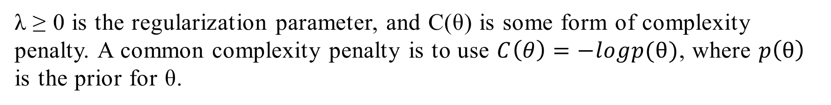
4.5 Regularization
--one of the main solution to overfitting
Regularization means we need to add a penalty term to the loss function.
λ ≥ 0 is the regularization parameter, and C(θ) is some form of complexity penalty. A common complexity penalty is to use $C\left(θ\right)=−logp(θ)$, where $p\left(θ\right)$ is the prior for θ.
MAP estimation

Slide 5

4.5.1 MAP estimation for Bernoulli distribution
-- An example
To avoid the case of zero count problem, we can add a penalty to θ to discourage “extreme” values. We can do this by using a beta distribution as our prior.
Where $a,b>1$
$$Beta\left(θ\right) \sim a/(a+b)$$
Set $a=b=2$, the estimate becomes:

Slide 6
4.5.3 Weight Decay
-- Another example
We find that using polynomial regression with too high of a degree can result in overfitting. The reason is that the complexity of the model is too high.
So maybe we can reduce the degree of the polynomial to solve the problem. But actually, a more general solution is to penalize the magnitude of the weights (regression coefficients).
L2 Regularization

Slide 7
4.5.3 Weight Decay
-- Another example

Slide 8
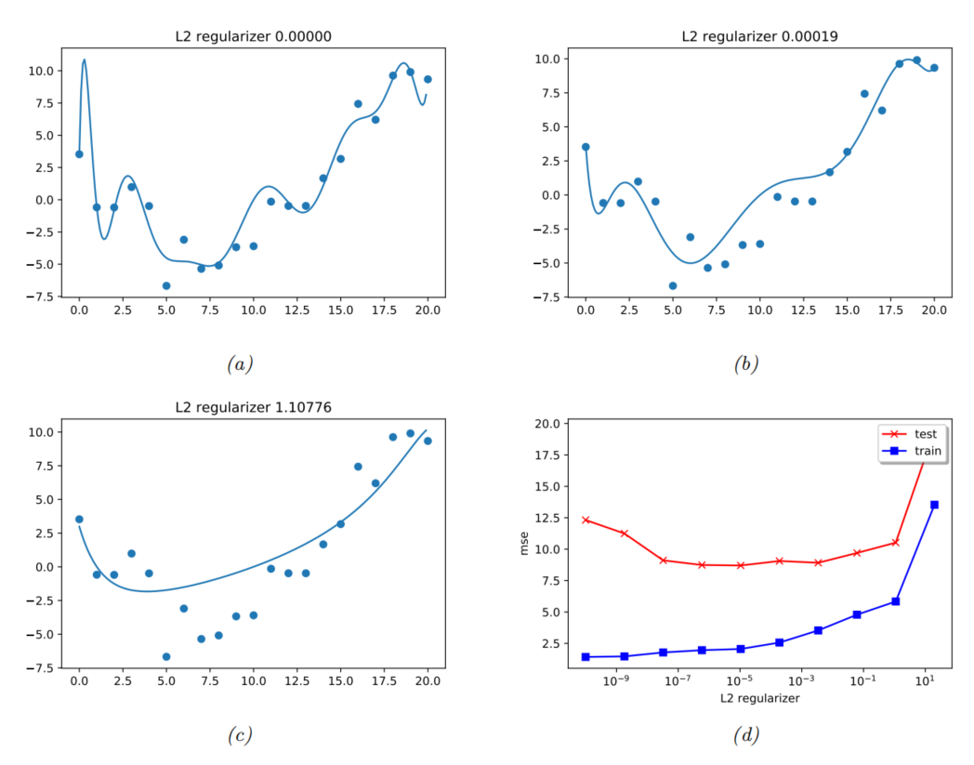

Slide 9
4.5.3 Weight Decay
Ridge regression
In the case of linear regression, this kind of penalization scheme is called ridge regression.
LASSO regression

Slide 10
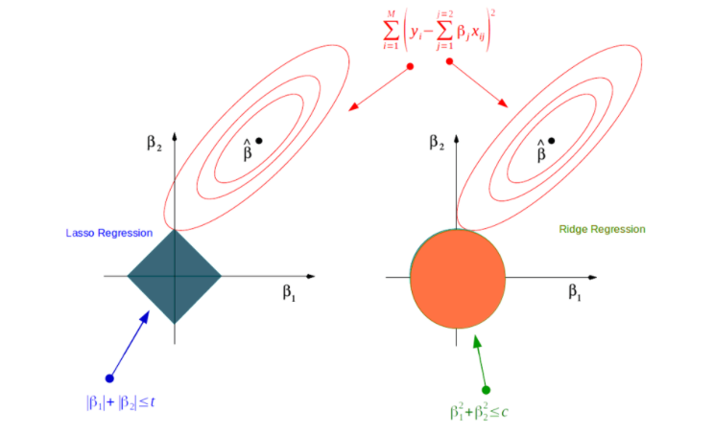

4.5.3 Weight Decay
$$β_{1}=0$$

Slide 11
4.5.4 Picking the regularizer using a validation set
Motivation
A key question when using regularization is how to choose the strength of the regularizer λ.

Slide 12
4.5.4 Picking the regularizer using a validation set
Process
For each λ, we compute the parameter estimate:
Then we compute the validation risk:
Finally, we pick:

Slide 13
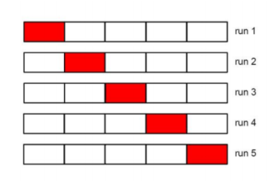
4.5.5 Cross-validation
How to split a validation set?
A simple but popular solution to this is to use cross validation (CV). The idea is as follows: we split the training data into K folds; then, for each fold k ∈ {1, . . . , K}, we train on all the folds but the k’th, and test on the k’th.
If we set K = N, we get a method known as
leave-one-out cross-validation

Slide 14
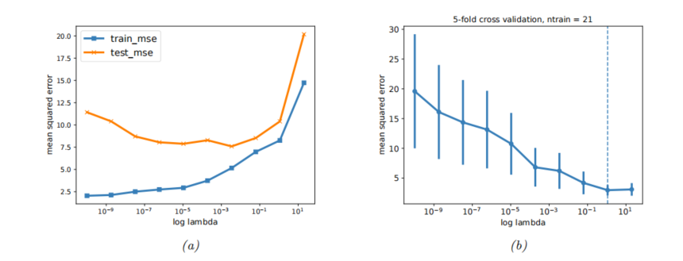
4.5.5 Cross-validation
-- An example
In Ridge regression

Slide 15
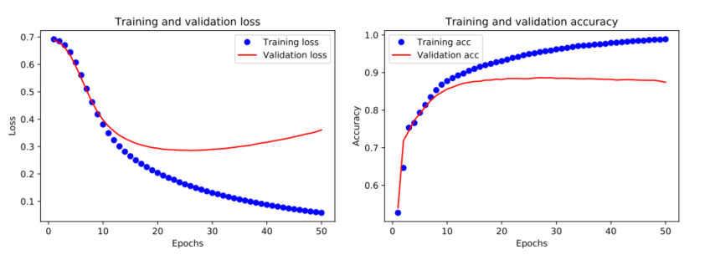
4.5.6 Early stopping
-- An simple form of regularization
This leverages the fact that optimization algorithms are iterative, and so they take many steps to move away from the initial parameter estimates

Slide 16
4.5.7 Using more data
-- An simple form of regularization
As the amount of data increases, the chance of overfitting (for a model of fixed complexity) decreases. (assuming the data contains suitably informative examples, and is not too redundant).

Slide 17
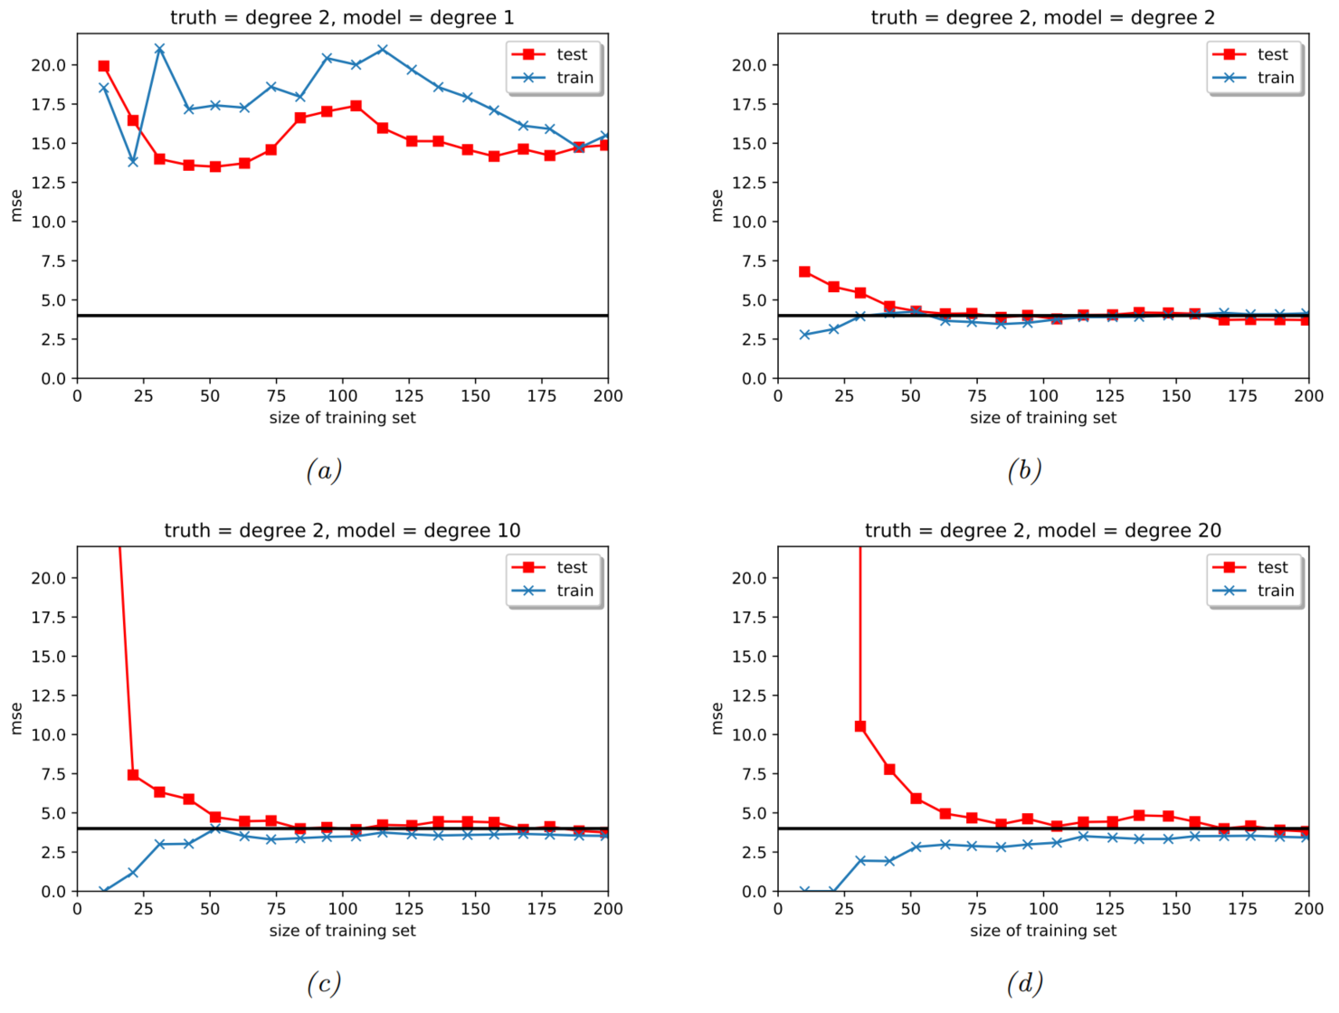

Slide 18
Thanks for your Listening
Yueze Fu
2022/12/02

